Slide 1
Tuskegee, Belmont and me— Ethics and Accessible UX
David Sloan
UX Research Lead, The Paciello Group
Accessibility Toronto 2020

Slide 2
2020

Slide 3
Accessible UX
Accessibility professionals know that there’s value in building on accessibility standards conformance by working with people with disabilities in the UX research, design and development process.

Slide 4
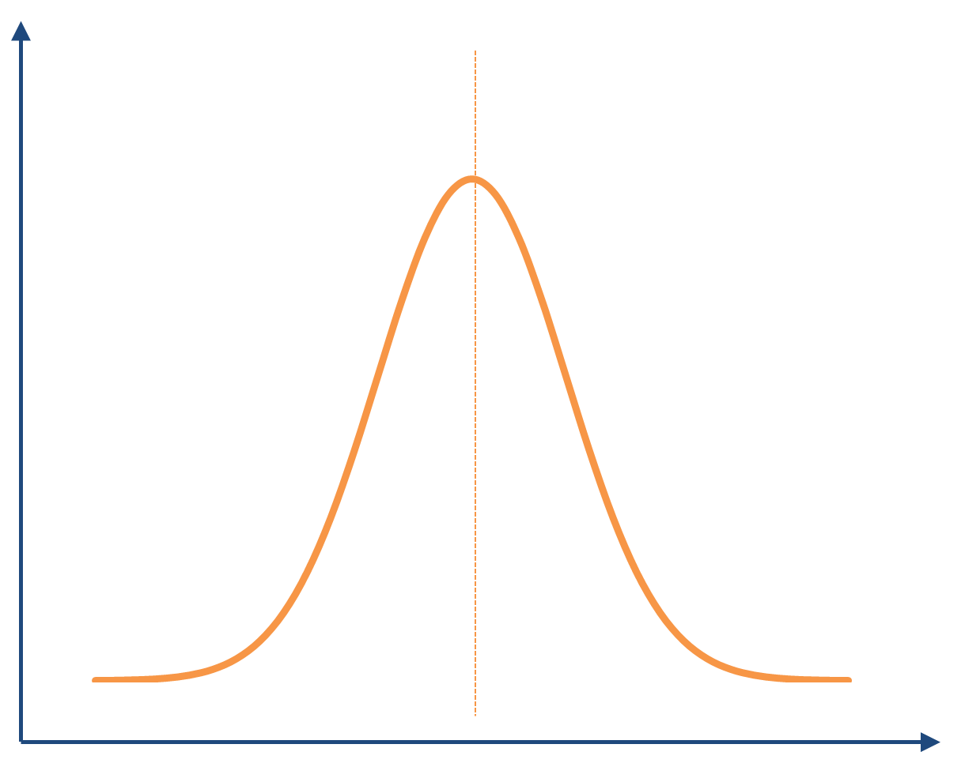
Bell Curve

Slide 5
Involving people with disabilities in UX research
UX research helps us:
Validate our assumptions about a problem space, including our users
Test our claims about what we think a solution will achieve

Slide 6
Involving people with disabilities in UX research
Generative research, activities to help us explore and discover more about a problem space in order to define a design problem
Evaluative research, activities to help us understand how well our designs solve the problem.

Slide 7
Are we doing enough user research with people with disabilities? And are we doing it in the right way?

Slide 8
Now seems like a good time to reflect on the ethical framework for why and how we should be involving people with disabilities in UX.

Slide 9
Tuskegee, and research ethics
The Tuskegee Syphilis Study (1932-72) was an example of a research study that exploited and violated the rights of participants, in this case African-American males.

Slide 10
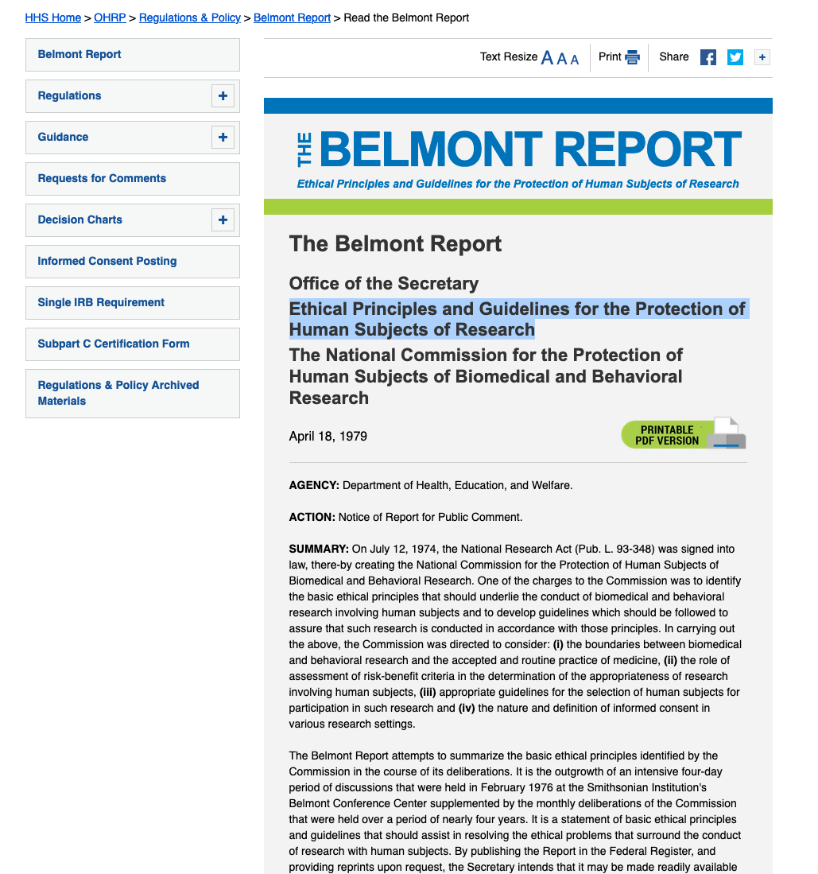
The Belmont Report Ethical Principles and Guidelines for the Protection of Human Subjects of Research https://www.hhs.gov/ohrp/regulations-and-policy/belmont-report/read-the-belmont-report/index.html

Slide 11
What does Belmont call “research”?
…an activity designed to test an hypothesis, permit conclusions to be drawn, and thereby to develop or contribute to generalizable knowledge (expressed, for example, in theories, principles, and statements of relationships).

Slide 12
1. Principle of Respect for Persons
Treat people as autonomous agents
Protect people with diminished autonomy

Slide 13
Respect for Persons in accessible UX
Provide an accessible informed consent process
Avoid unnecessary deception
Don’t place undue demands on people with disabilities to participate.
Avoid undue intrusions of privacy
Focus on disabled people’s usage of technology over medical history
Avoid involuntary disclosure of identity

Slide 14
2. Principle of Beneficence
Protect people from harm
Maximize possible benefits and minimize possible harms

Slide 15
Beneficence in accessible UX
Design research activities to minimize harm and maximize benefit
Adjust scheduling, location and methodology to:
Avoid undue physical effort in carrying out research activities
Avoid the mental stress of being asked to interact with an inaccessible product, especially one that is known to be inaccessible
Avoid placing financial demands on participation (requiring transport, demanding participants use their own data connection)

Slide 16
3. Principle of Justice
The burden of participation should be compensated by the benefits of the research contribution
Research participants should benefit from the discoveries of the research

Slide 17
Justice in accessible UX
Ask the right research questions!
Make sure as far as you can that participants and others with similar accessibility needs will benefit
Look at intersectionalism and disability, in order to try to get a cross-section of perspectives,
Adapt recruitment methods and session scheduling accordingly
Accept the risk that you may identify issues but don’t resolve them.
You raise expectations amongst participants, so manage expectations
And let them know about the impact of the research

Slide 18
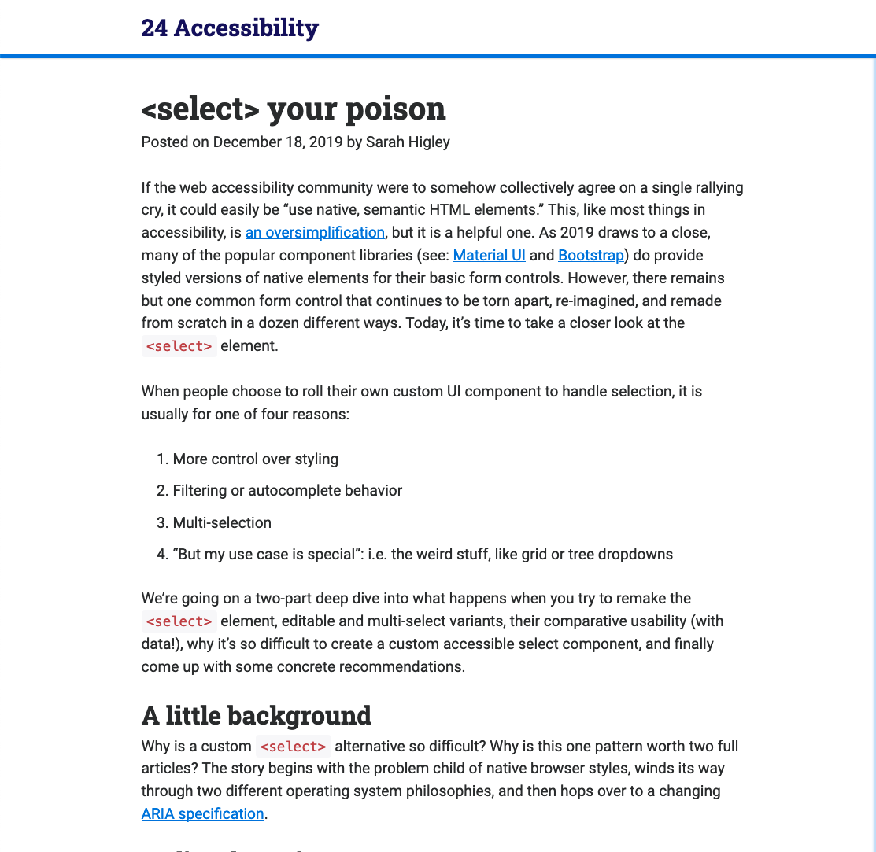
Sharing results of user research: Sarah Higley’s “Select your poison” https://www.24a11y.com/2019/select-your-poison/

Slide 19
Share your user research findings!
Who took part?
What was tested?
How did you test?
When the study took place?
What did you find?
Any limitations to applying your findings?

Slide 20
Challenge your assumptions. Test your claims.

Slide 21
Email: dsloan@paciellogroup.com
Twitter: @sloandr
LinkedIn: https://www.linkedin.com/in/sloandr/

